Slide 1


BZAN 545
The ADAM Project
Automatic Data Acquisition and Management

Slide 2
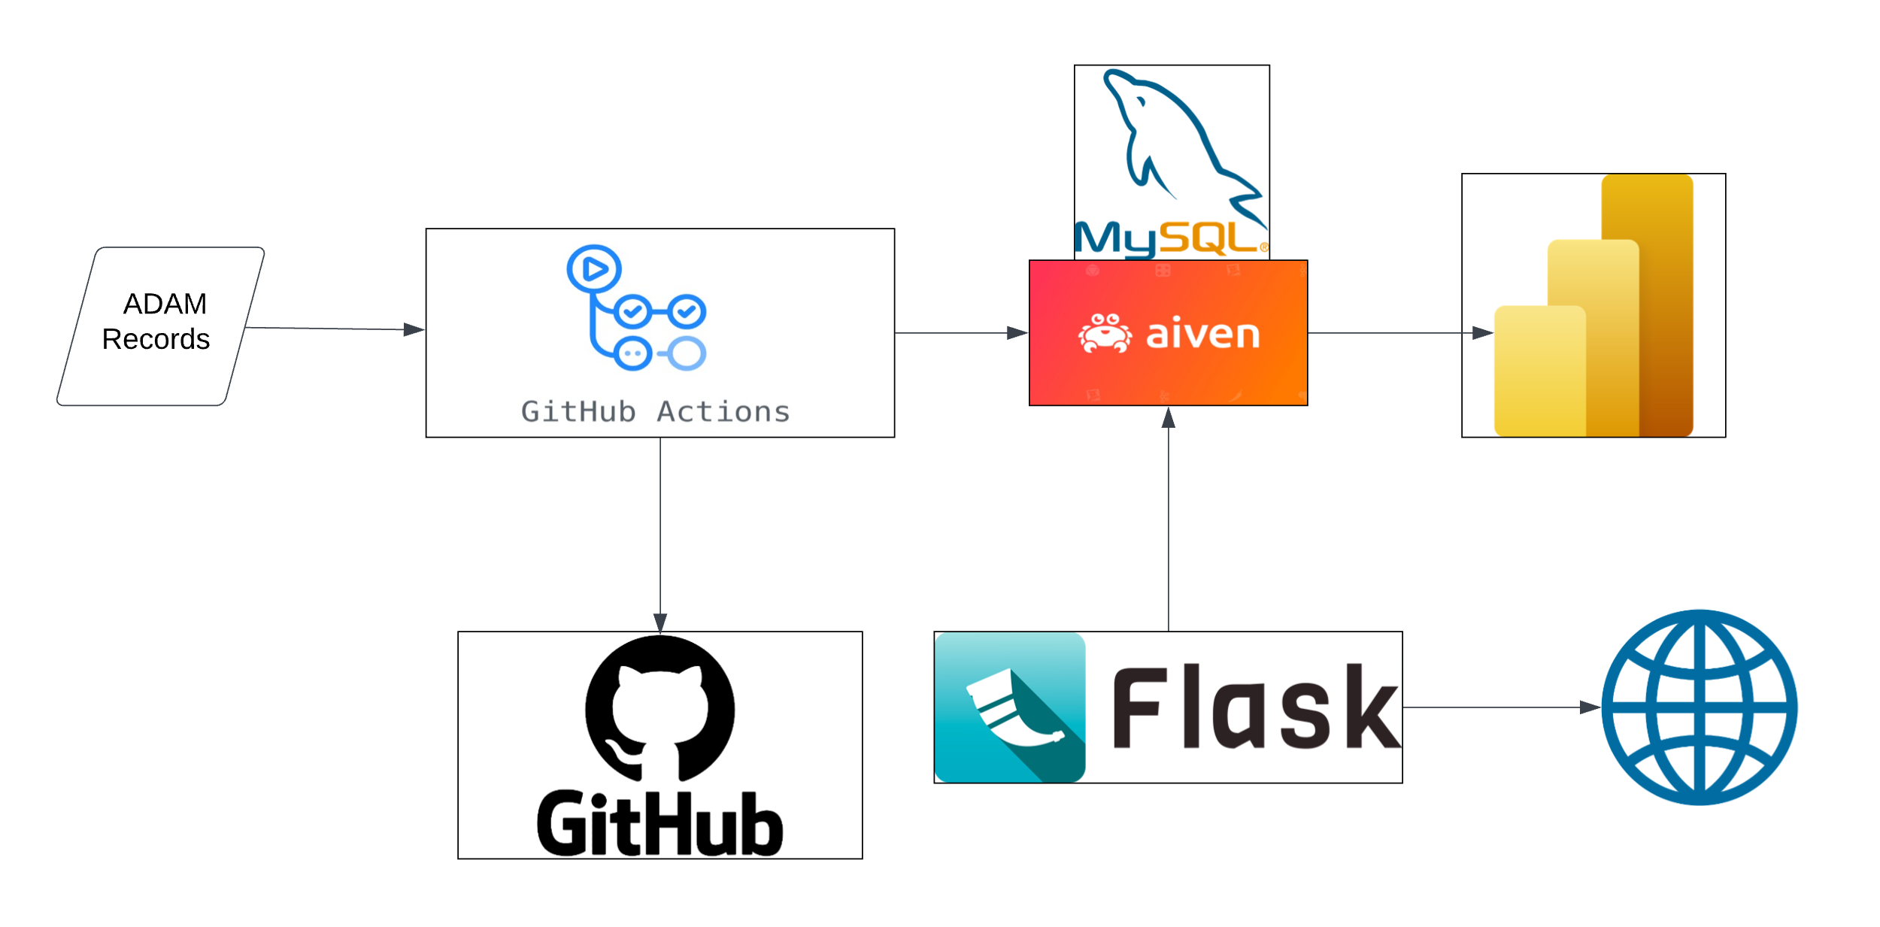


ADAM Infrastructure

Slide 3



Chosen
Alternatives

Slide 4
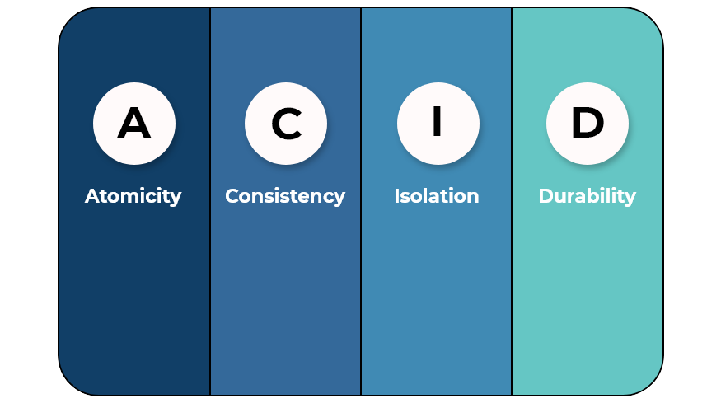
MySQL Justification
Advantages | Disadvantages
1. Open Source | 1. Limited Functionality
2. Scalability | 2. ACID Compliance
3. Community Support | 3. Ownership and Licensing

Slide 5

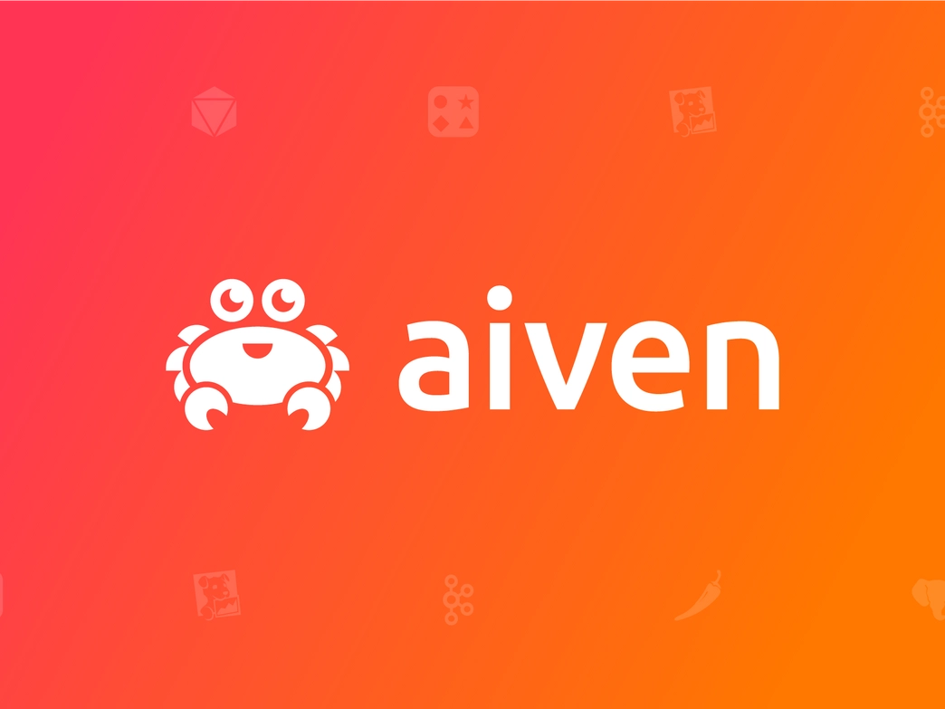


Chosen
Alternatives

Slide 6
aiven Justification
Advantages | Disadvantages
1. Free (for the base offering) | 1. Cost - Can be more expensive than self-hosting
2. Managed Services | 2. Limited Control over Infrastructure
3. Multi-Cloud Support | 3. Reliance on Aiven's Service Reliability

Slide 7

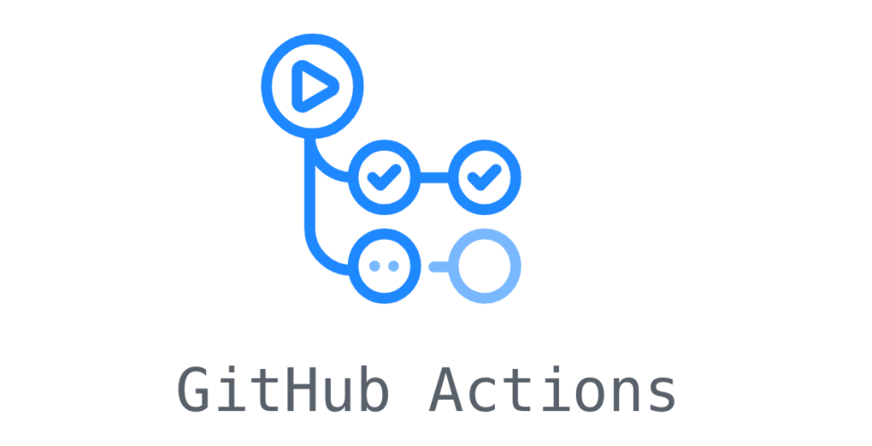

Chosen
Alternatives

Slide 8
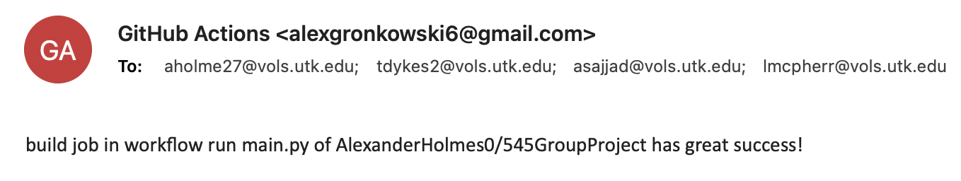


Slide 9
GitHub Actions Justification
Advantages | Disadvantages
1. Continuous Integration and Automation | 1. Limited Concurrency for Free Accounts
2. Integration with GitHub repositories | 2. Learning Curve for Complex Workflows
3. Large Ecosystem of Community-Made Actions | 3. Cost for Heavy Usage

Slide 10


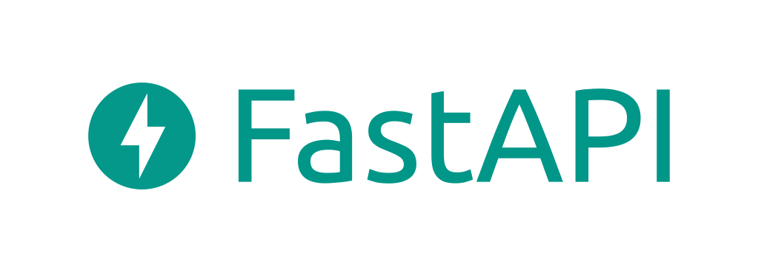
Chosen
Alternatives

Slide 11
Flask Justification
Advantages | Disadvantages
1. Simplicity | 1. Limited Built-in Features
2. Flexibility | 2. Not Ideal for Large Projects
3. Community and Ecosystem | 3. Security Concerns

Slide 12
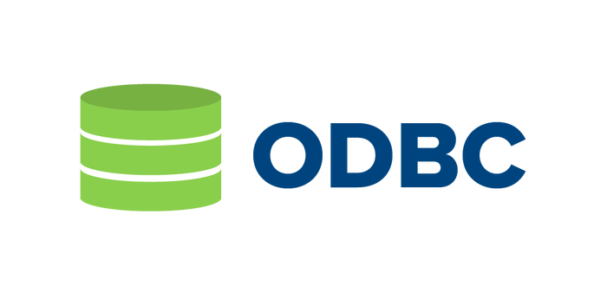
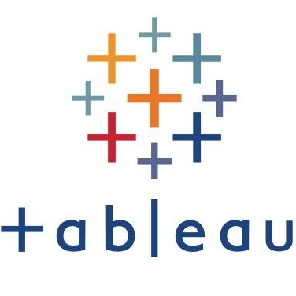


Chosen (At the Moment)
Alternatives

Slide 13
PowerBI Justification
Advantages | Disadvantages
1. Data Visualization | 1. Learning Curve for Complex Data Modeling (DAX)
2. Ease of Use | 2. Limited Non-Microsoft Integration
3. Integration | 3. Cost Scalability as User Base Grows

Slide 14
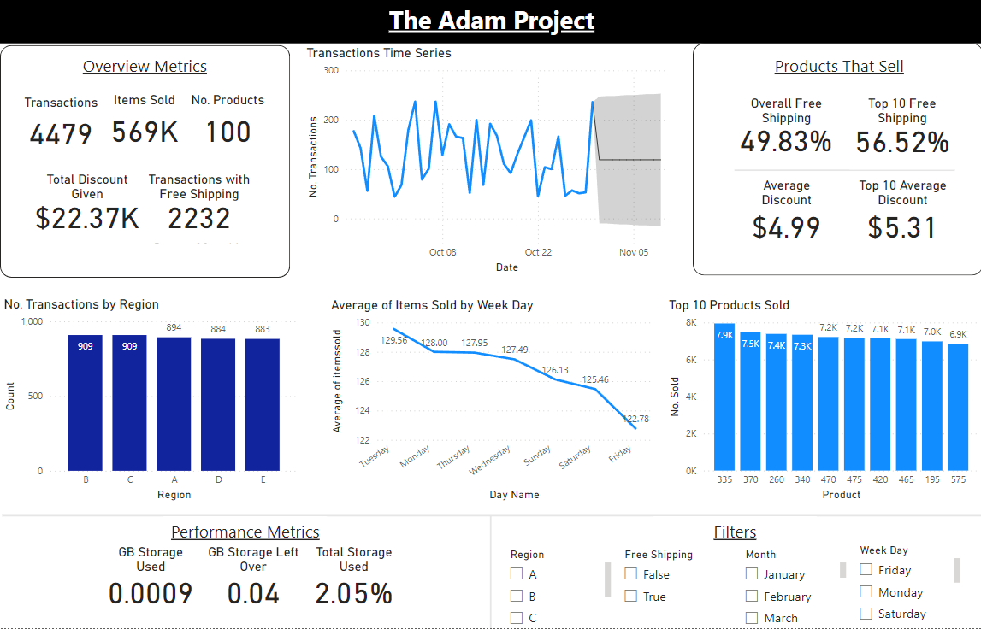

Slide 15
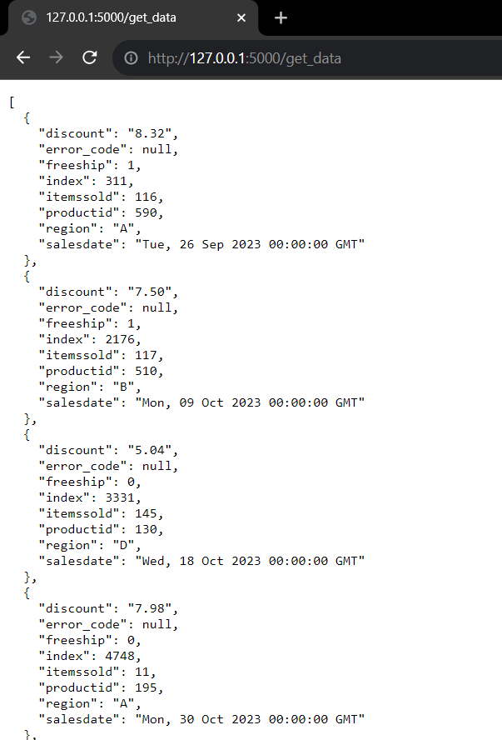

Slide 16
Next Steps
Flask API: Update API Code to Accept User Input
May have to hard pivot to Tableau or Shiny Python

Slide 17
Thanks!
Any Questions?

